Slide 1


Bike Dekho—Bike Sales Analysis Project Analyzing Sales Data Using Microsoft Excel Presented by:
Somanjan Chakraborty

Slide 2
Project Overview
Hands-on data analysis project for the biking industry
Utilizes Microsoft Excel for cleaning, analysis, and dashboarding
Goal: Turn raw data into actionable business insights

Slide 3
Project Objectives
Clean and organize bike sales data
Perform exploratory data analysis (EDA)
Uncover key sales and customer trends
Build an interactive dashboard for decision-making

Slide 4
Key Tasks Performed
Data Cleaning & Preprocessing
Exploratory Data Analysis (EDA)
Data Visualization using charts
Dashboard Design for executives

Slide 5
Data Cleaning & Preprocessing
No duplicates or missing values in raw file
Currency data standardized (USD)
Created Age Bracket: =IF(L2>54,"Old",IF(L2>=31,"Middle Age",IF(L2<31,"Adolescent","Invalid")))

Slide 6
Exploratory Data Analysis
Using PivotTables to uncover patterns:
Purchased Bikes by Gender & Region (Male: 525, Female: 501 across regions)
Age vs. Purchase Preference (Middle Age: 393 purchases, Adolescent: 41)
Income and Occupation’s effect on buying behavior (Higher income correlates with higher purchase rate)

Slide 7
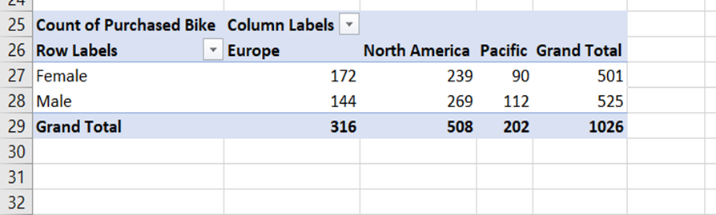
Sales by gender, region, and product category

Slide 8
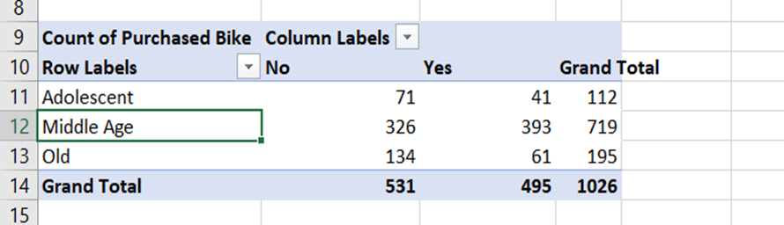
Preferred bike models by customer demographics

Slide 9
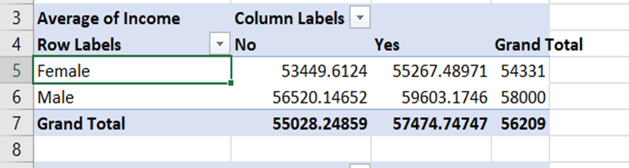
Impact of income and occupation on bike purchasing behavior

Slide 10
Excel Functions Used
IF, COUNTIFS, SUMIFS, VLOOKUP
Used for age bucketing, filtering purchases, calculating averages

Slide 11
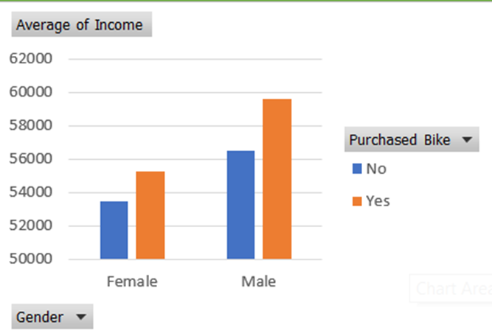
Data Visualizations
Bar & Column charts: Gender-Wise Income vs. Purchase

Slide 12
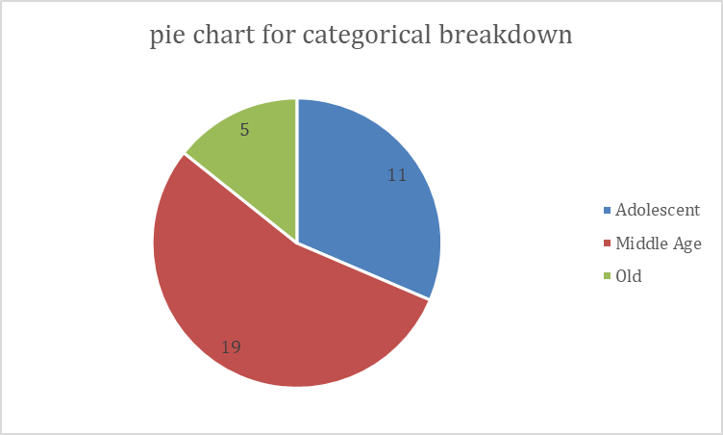
Pie charts
Age category breakdown

Slide 13
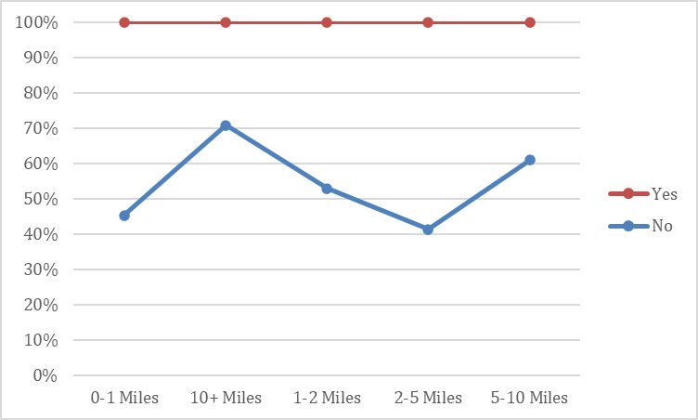
Line charts
Commute distance vs purchase trend

Slide 14
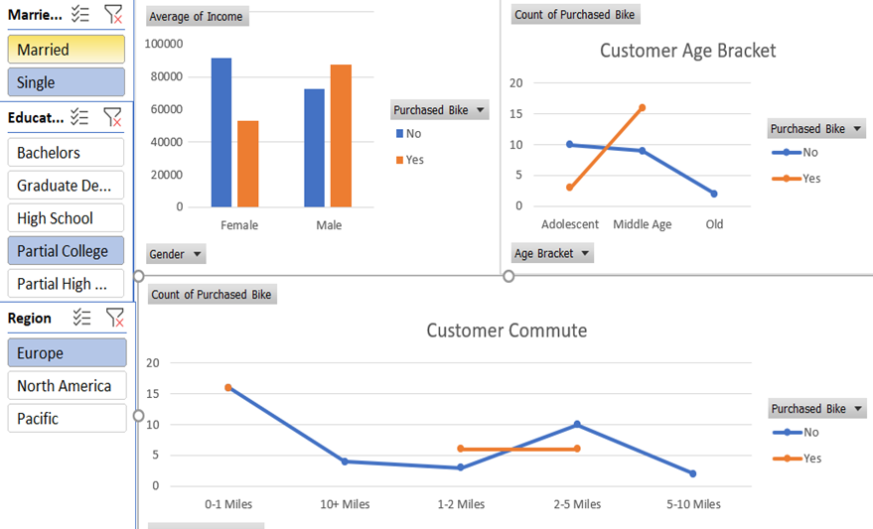
Slicers & Filters
Gender, Region, Marital status, Education

Slide 15
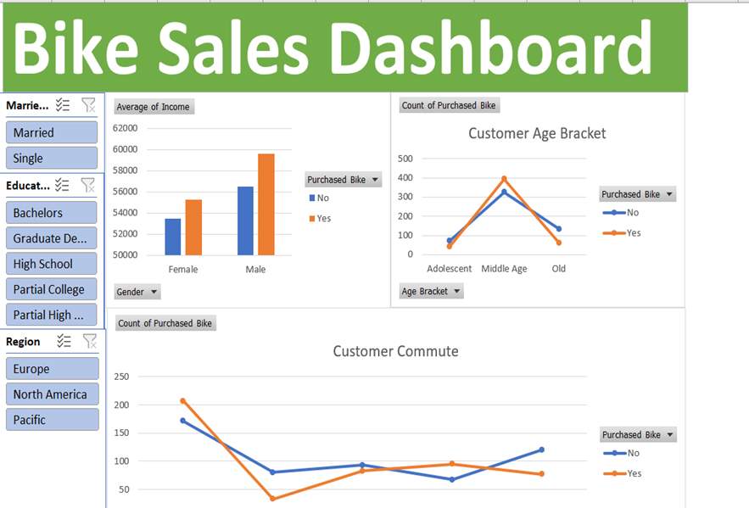
Dashboard Overview
KPIs: Units Sold, Avg. Income, Customer Count
Interactive segments: Region, Gender, Commute Distance
Clear visual layout with color-coded charts

Slide 16
Business Insights
Most frequent buyers: Married males (30–45) with high income
Mountain bikes are top choice
Western regions record highest sales
Purchasing influenced by income & occupation

Slide 17
Skills Demonstrated
Data Cleaning and Formatting
PivotTable Analysis
Formula-Based Insights
Dashboard Reporting & BI Visualization

Slide 18
Have a nice day
Thank you.

